Slide 1
Typesetting with T_{E}X / L^{A}T_{E}X
Part II: Formatting and Layout

Slide 2
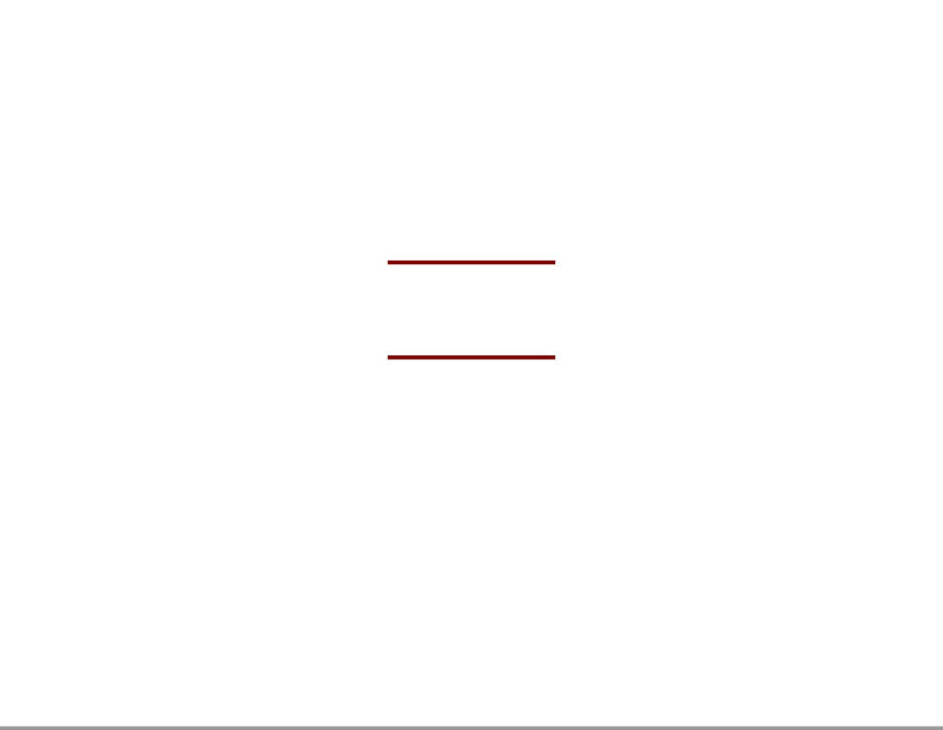
Lists

Slide 3
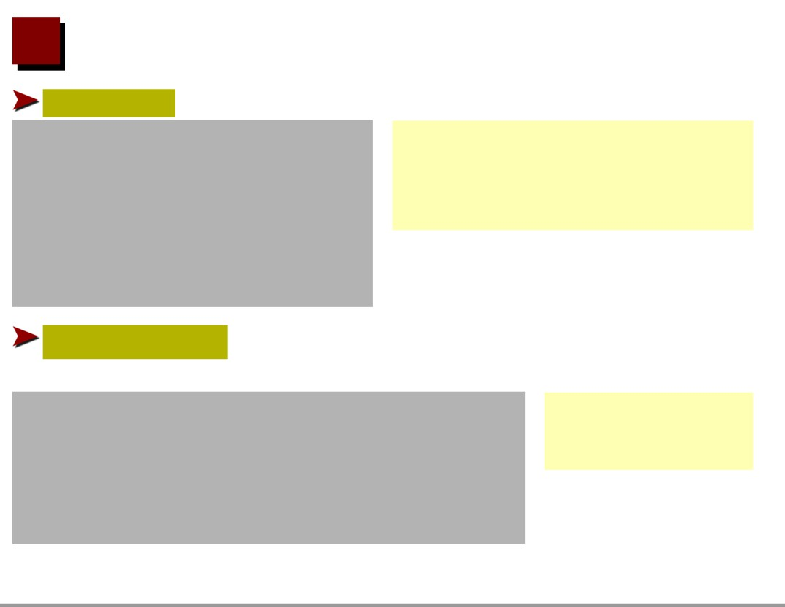
Itemize
Bullet lists are created by an itemize environment:
\begin{itemize} \item First item.
• First item.
• Second item.
\item Second item. \item Third item. \end{itemize}
• Third item.
Change labels on a case-by-case basis by using an op- tional argument:
\begin{itemize}
♣ clubs
\item[$\clubsuit$] clubs
♥ hearts
\item[$\heartsuit$] hearts \end{itemize}

Slide 4

Nested Itemize Environments
Up to four itemize environments may be nested :
\begin{itemize} \item Item 1
• Item 1 - Item 1.1
\begin{itemize} \item Item 1.1 \item Item 1.2 \end{itemize} \item Item 2
- Item 1.2
• Item 2
- Item 2.1
\begin{itemize} \item Item 2.1 \end{itemize} \end{itemize}

Slide 5
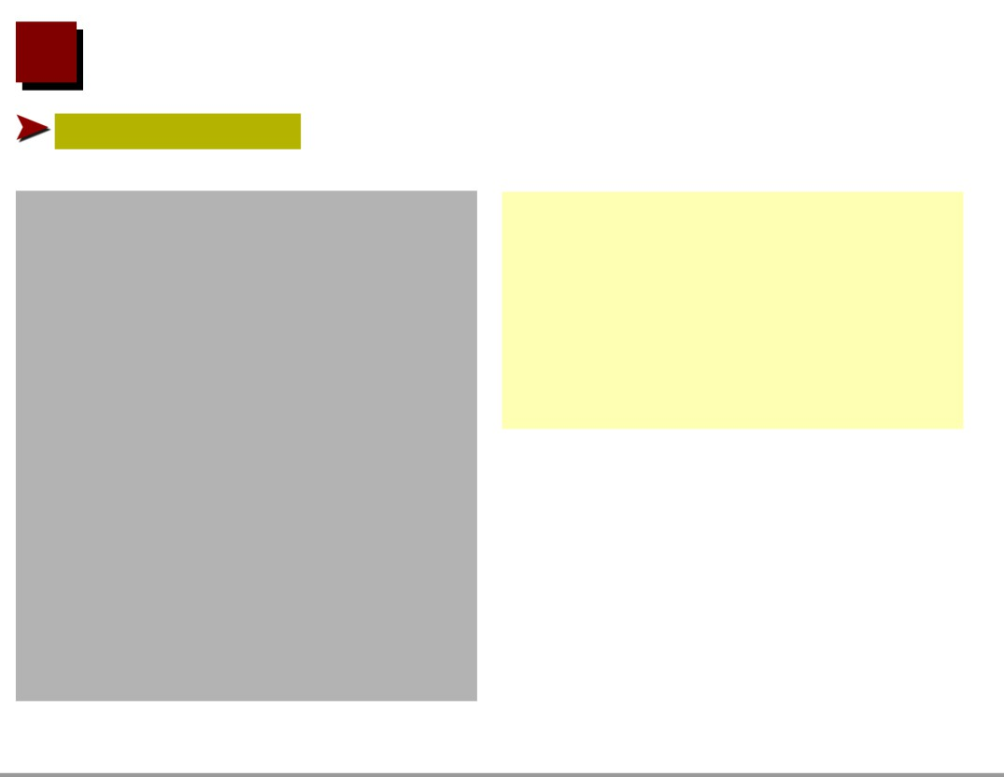
Enumerate
Numbered lists are generated like itemized lists in an enumerate environment:
\begin{enumerate} \item Item 1
1. Item 1 (a) Item 1.1
\begin{enumerate} \item Item 1.1
(b) Item 1.2
2. Item 2
\item Item 1.2 \end{enumerate} \item Item 2
(a) Item 2.1
\begin{enumerate} \item Item 2.1
\end{enumerate} \end{ernumerate}

Slide 6
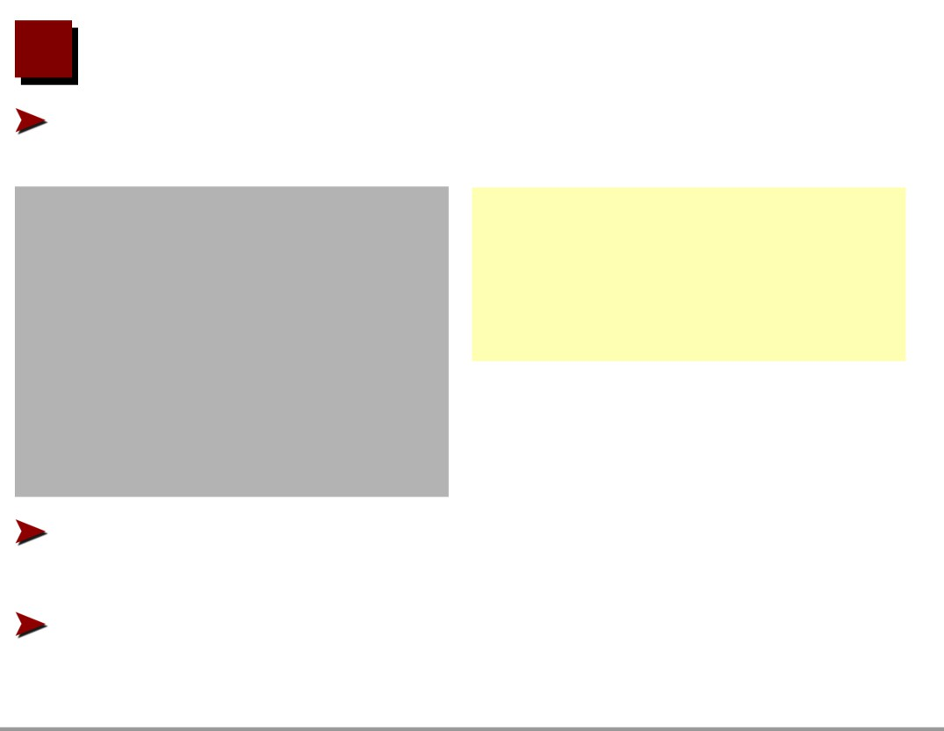
Enumerate and Itemize Lists
Enumerate and itemize lists may be nested (level is handled separately)
\begin{itemize} \item Item
• First:
1. Enum 1
\begin{enumerate} \item Enum 1
2. Enum 2
\item Enum 2 \end{enumerate} \end{itemize}
Optional \item argument to set label can also be used for enumerate
Check out the enumerate package for more numbered list styles

Slide 7
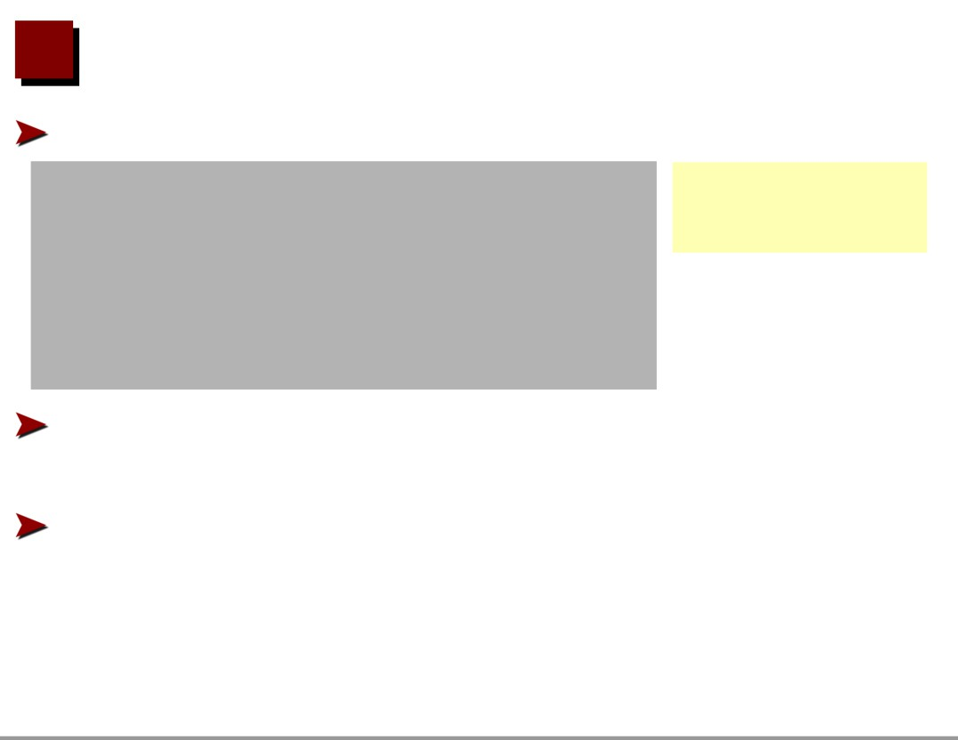
Change Labels Globally
The default label can be redefined for the whole level:
\begin{itemize}
⋆ Item 1
\renewcommand{\labelitemi}{$\star$}
⋆ Item 2
\item Item 1 \item Item 2 \end{itemize}
This can be done at all four levels in enumerate and itemize environments (see literature)
Similarly spacing between items and other dimensions can be adjusted (see literature)

Slide 8

Description
For glossaries, etc. use description environment:
\begin{description} \item[Cabbage] A large round green vegetable \item[Brussel sprout] A small round green
Cabbage A large round green vegetable
Brussel sprout A small round green vegetable
vegetable \end{description}

Slide 9
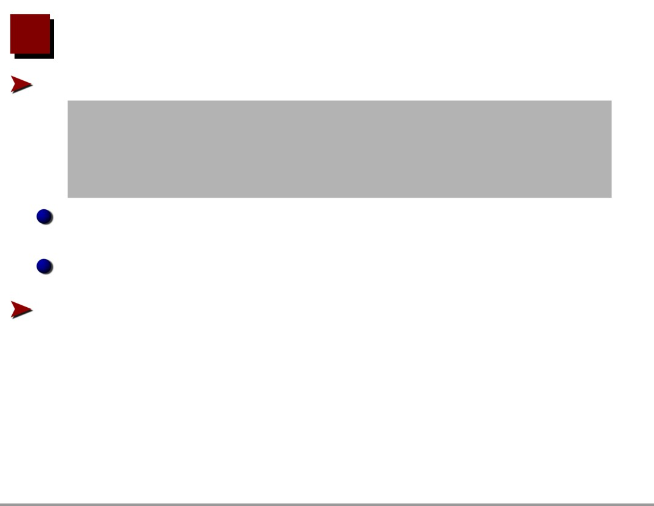
General Lists
General lists may be created using the list environment: \begin{list}{label}{declarations}
\item first item ...
\end{list}
label: is the label for any items not specifying their own
declarations: list definition (lengths,. . . ) commands Example for a list in a CV:

Slide 10

EDUCATION
Ph.D., Engineering Mechanics, 1993 University of Wisconsin-Madison
M.S., Engineering Science, 1987 Harvard University
EXPERIENCE
Some jobs here and some jobs there.

